Slide 1
PATIENT STROKE PREDICTION ANALYSIS
BY
JOTHEESWARAN S
PRADEEP KUMAR S
SRIDHAR P

Slide 2
AGENDA
1. Objectives
2. Data & Methodology
3. SQL Insights
4. Exploratory Data Analysis (EDA)
5. Recommendations
6. Limitations & Next Steps
7.Machine Learning Model
8.Feature Importance
9.Deployment
10.Key Learnings & Future Scope

Slide 3
OBJECTIVES
Measure stroke prevalence and identify high-risk groups
Use Excel for Data Cleaning
Use SQL queries to derive grouped insights
Use Power BI to perform EDA with charts (age, gender, BMI, etc.)
Provide actionable recommendations
Build Machine Learning Model to predict the risk group of patient stroke
Deploy the Best Model using Streamlit

Slide 4
DATA & METHODOLOGY
SOURCE:
stroke_analysis.csv & stroke_analysis.xlsx
(5,110 records)
Structured with demographic + health features
stroke_analysis.sql includes
GROUP BY & AVG queries
Stroke analysis.pbix for
Data Visualization
Target variable:
stroke (0/1)

Slide 5
SQL INSIGHTS
Gender:
Stroke rate ~5.11% (Male) vs 4.71% (Female)
Hypertension:
13.25% vs 3.97% (Non-hypertensive)
Work type:
Self-employed highest rate (7.94%)
AVG BMI:
Higher in stroke patients (30.47 vs 28.82)
AVG Glucose:
Higher in stroke patients (esp. >125 mg/dL)

Slide 6
EXPLORATORY DATA ANALYSIS
Overall stroke rate:
4.87% (249/5110)
Age:
61+ category shows highest rate (13.57%)
Smoking:
Former smokers' highest crude rate (7.91%)
Residence:
Urban slightly higher (5.2% vs 4.5%)

Slide 7
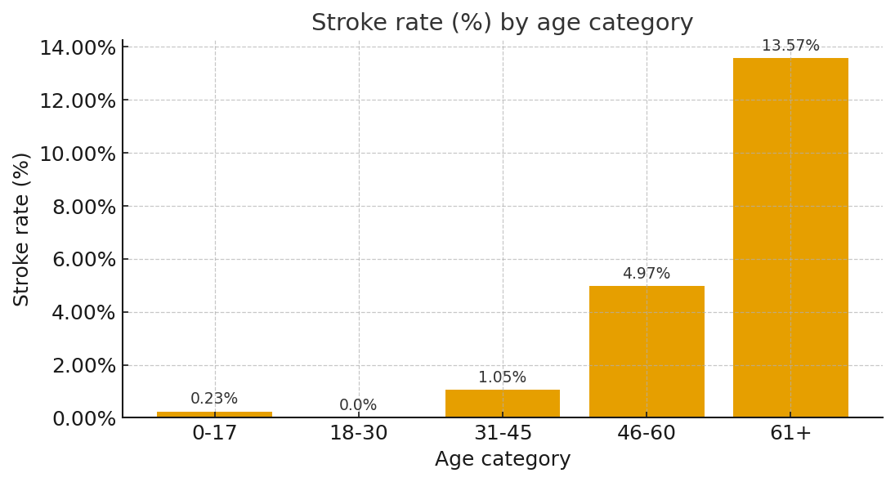
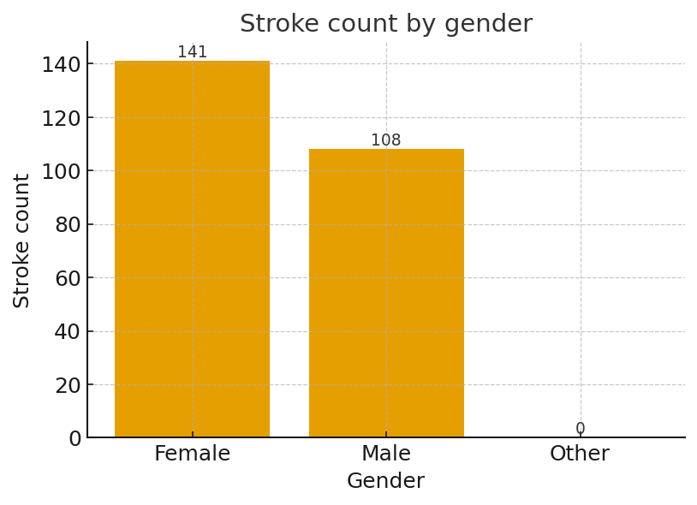
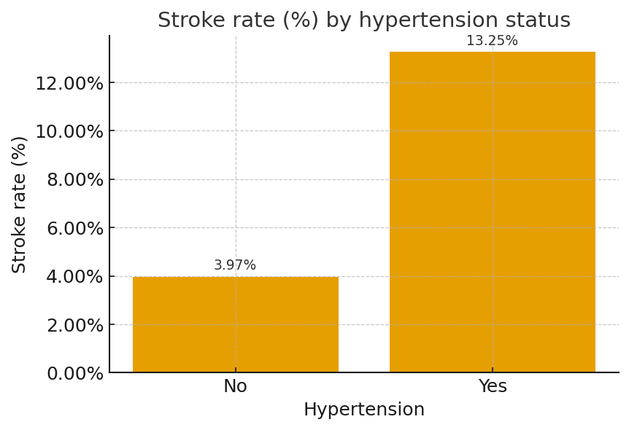
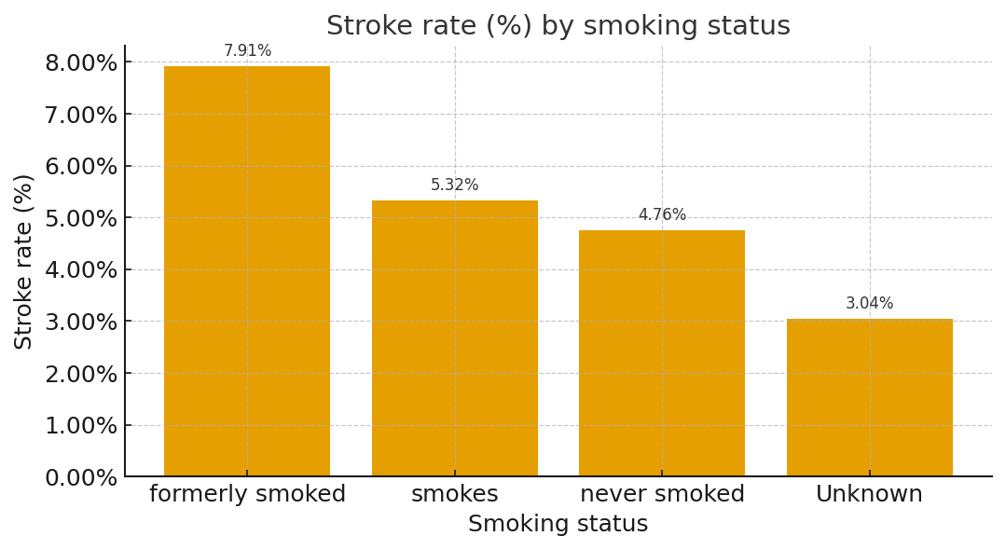

Slide 8
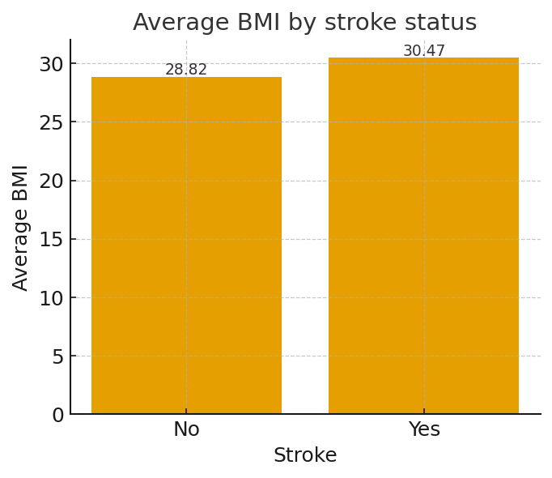
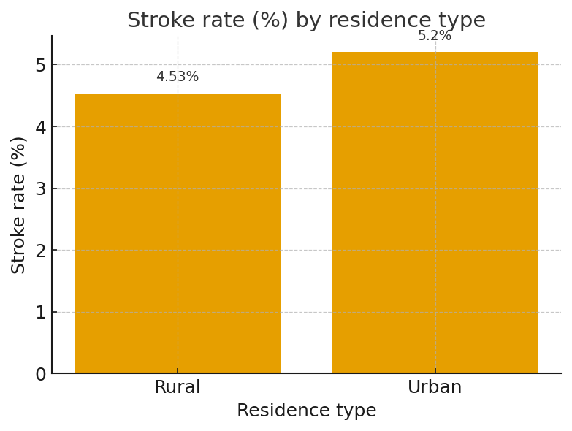
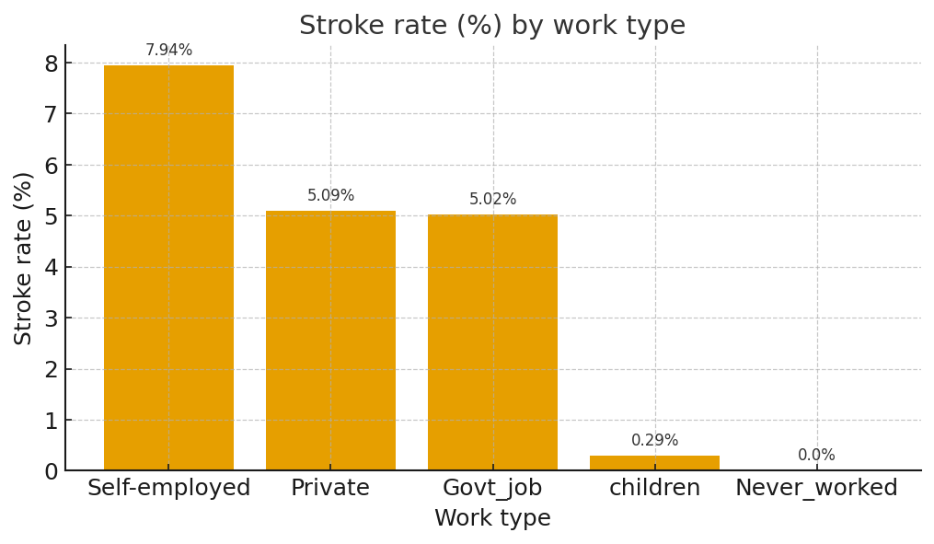
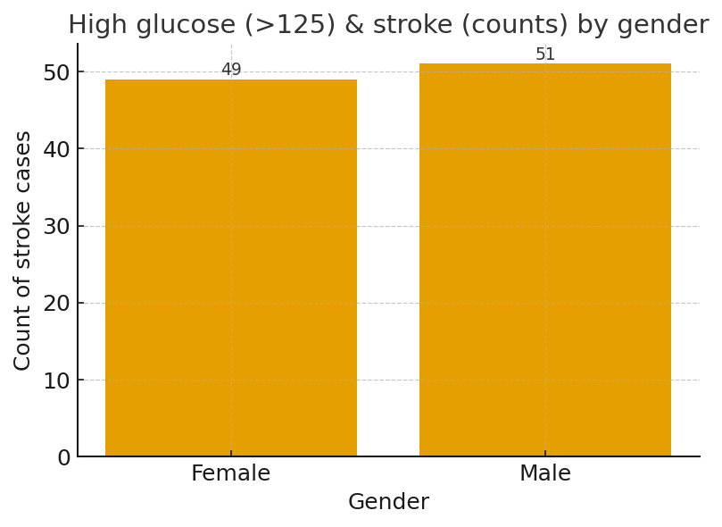

Slide 9
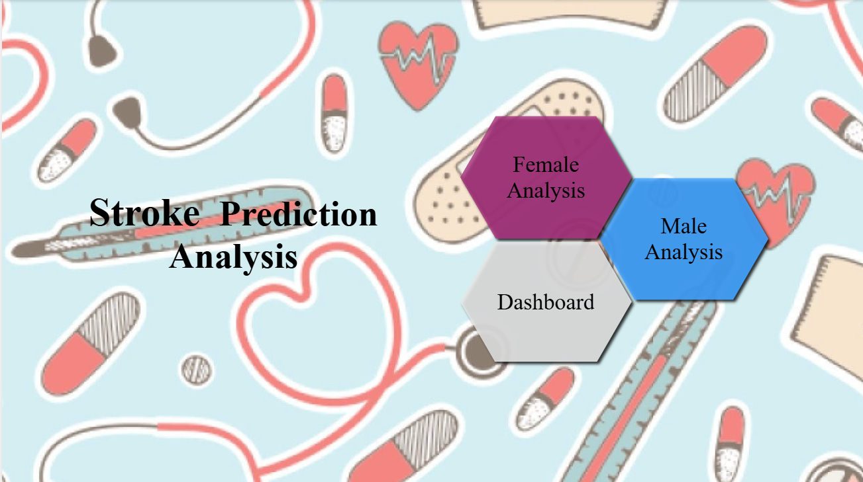
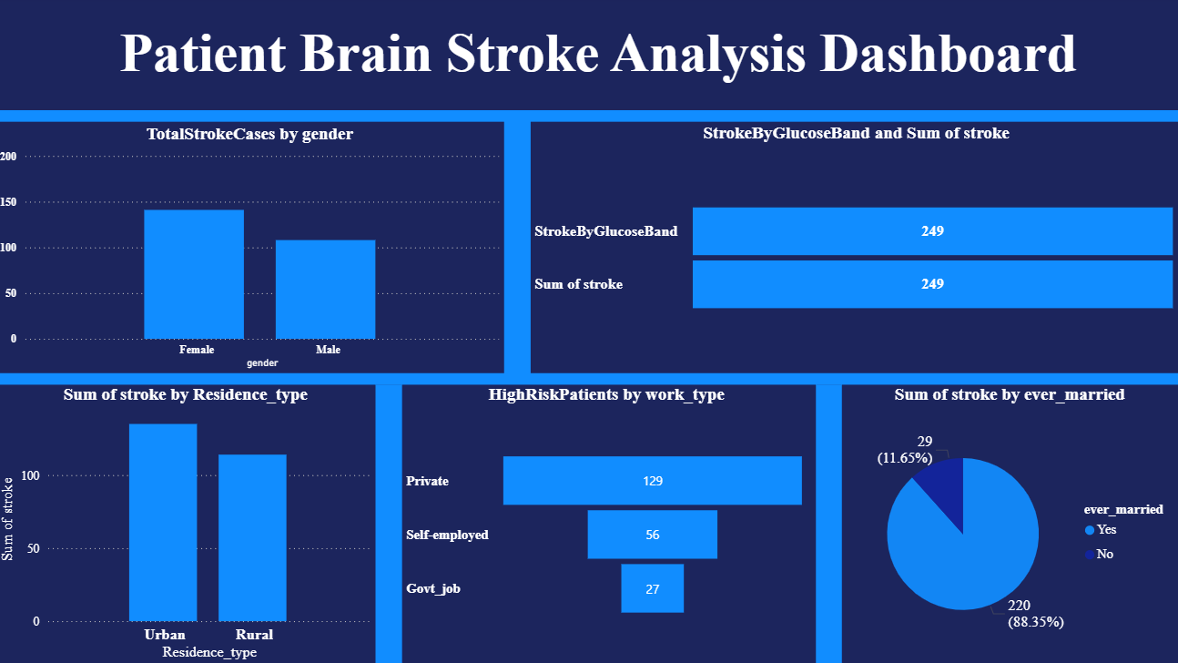
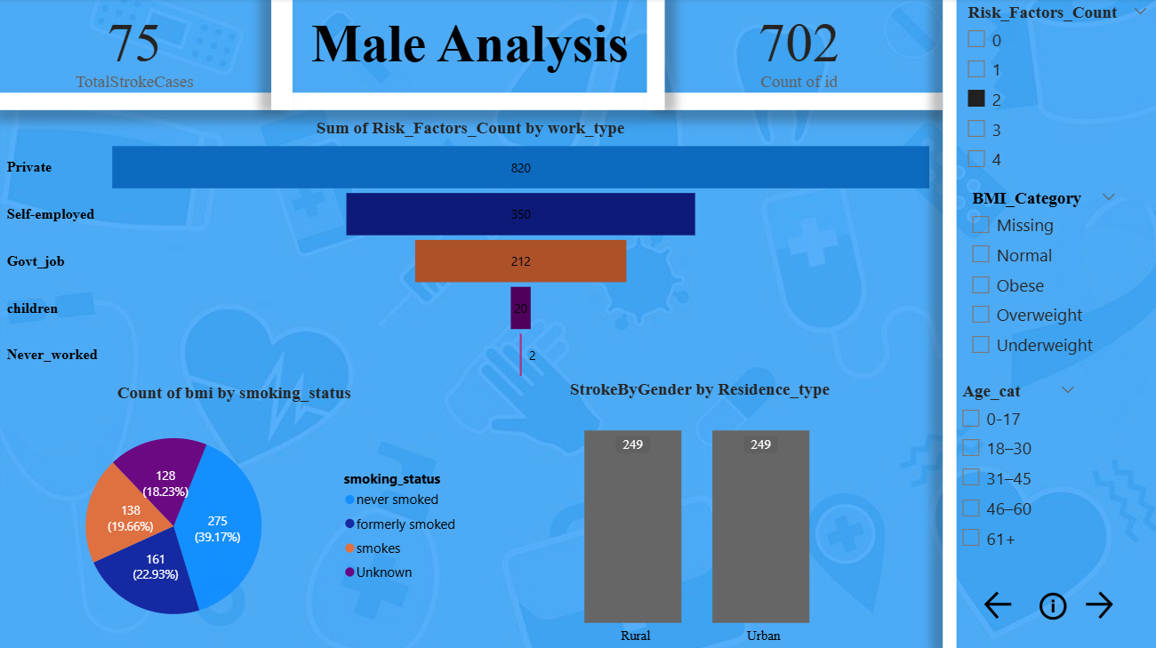
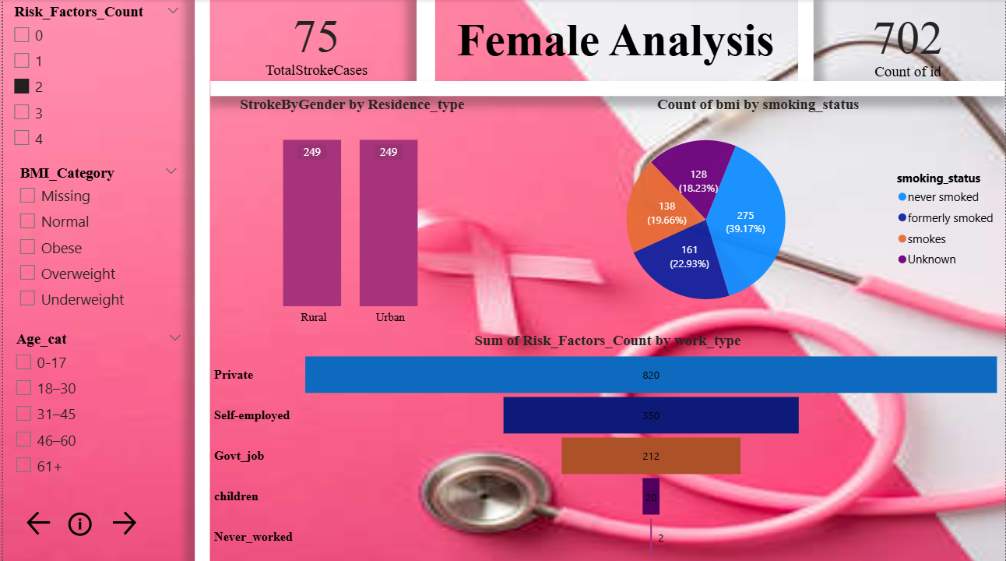

Slide 10
RECOMMENDATIONS
Screening & BP control for adults >45 (focus 61+)
Target smoking cessation & metabolic health programs
Use regression for age-adjusted modelling
Focus outreach: Urban + Self-employed groups

Slide 11
LIMITATIONS & NEXT STEPS
Observational dataset — confounding possible
Missing values & categorical imbalance
Next: multivariable regression, risk scoring
Validate with external datasets

Slide 12
MACHINE LEARNING MODEL
• DATA PREPROCESSING:
Missing value imputation
Scaling: age, avg_glucose_level, BMI
Encoding: gender (ordinal), work_type & smoking_status (one-hot)
• Model Selection:
XGBoost Classifier chosen from GridSearchCV and SMOTE is used for handling imbalanced data
• Training:
Trained on 80% data, validated on 20%
• Evaluation Metrics:
Accuracy, Precision, Recall, F1-Score
• Key Insight:
Focused on minimizing false negatives to avoid missing high-risk cases

Slide 13
FEATURE IMPORTANCE
Age, avg_glucose_level, BMI are top predictors
Hypertension & heart_disease strongly influence risk
Work type & smoking status have moderate effect
Gender shows minimal contribution

Slide 14
DEPLOYMENT
Built with Streamlit for real-time prediction
• User fills inputs:
gender, age, hypertension, heart disease, work type, glucose, BMI, smoking status
• App performs:
scaling, encoding, combines features → passes to XGBoost model
• Output:
⚠️ High Risk or ✅ Low Risk with medical disclaimer
•Workflow:
User Input → Feature Scaling & Encoding → Model Prediction → Risk Result

Slide 15
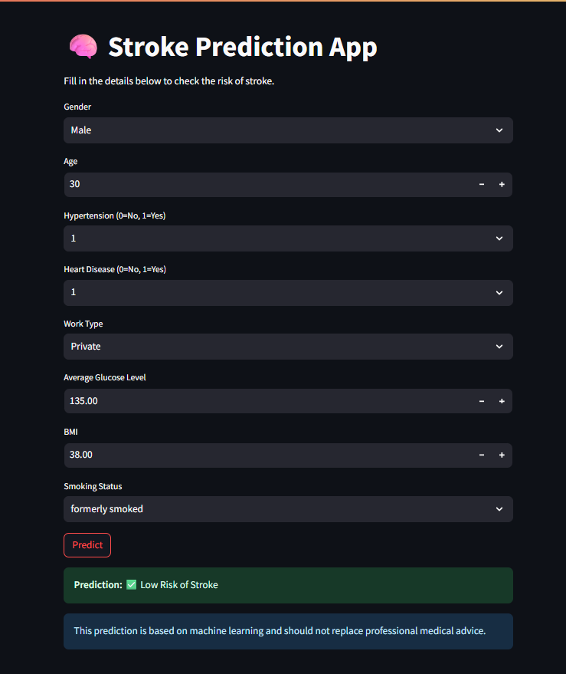

Slide 16
KEY LEARNINGS & FUTURE SCOPE
• Learned complete ML workflow:
data preprocessing → model selection → hyperparameter tuning → evaluation
• Integrated XGBoost model into Streamlit for practical use
• Future Scope:
– Deploy on AWS/Heroku for public access
– Add SHAP explainability for transparent predictions

Slide 17
THANK YOU!

